Slide 1
CSCI 580 Discussion
Week 6 – Shading & Demos
Rongqi Qiu
rqiu@usc.edu

Slide 2
Outline
Reflection Model (last Thursday’s lecture)
Ambient
Diffuse
Specular
Shading Model (this Thursday’s lecture)
Flat
Gouraud
Phong
Q & A

Slide 3
Reflection Model
Also called illumination or lighting model
Three components:
Ambient + Diffuse + Specular = Reflection
Shading Model
Interpolation techniques
Three methods:
Flat, Gouraud, Phong Shading
Demo

Slide 4
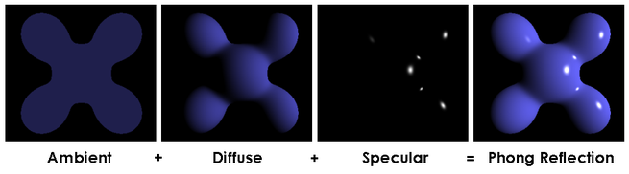
Reflection Model
Ambient reflection
Diffuse reflection
Specular reflection

Slide 5
Ambient Reflection
Ambient component = Ia Ka
Constant everywhere
Depend on ambient light in the environment
Independent of individual directional lights

Slide 6
Diffuse Reflection
Diffuse component = Ie Kd (N•L)
Depend on surface normal and light direction
Only applies to front surfaces, not back ones
View-independent

Slide 7
Specular Reflection
Specular component = Ie Ks (R•E)^{spec}
Only affects a small area
View-dependent
“spec” exponent controls distribution of energy

Slide 8
Outline
Reflection Model (last Thursday’s lecture)
Ambient
Diffuse
Specular
Shading Model (this Thursday’s lecture)
Flat
Gouraud
Phong
Q & A

Slide 9
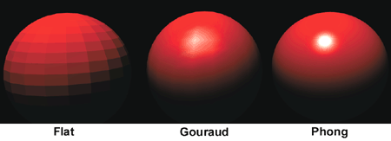
Shading
When to apply the equation?
Per-face (Flat Shading)
Per-vertex (Gouraud Shading)
Per-pixel (Phong Shading)

Slide 10
Flat Shading
Evaluate shading equation once per face
Constant color
Requires high tessellation

Slide 11
Tessellation
The level of subdivision of a triangle mesh
Roughly measured by number of triangles

Slide 12
Gouraud Shading
Evaluate shading equation once per vertex
Interpolate color within a face
Fast, but loses details inside faces

Slide 13
Phong Shading
Evaluate shading equation once per pixel
Interpolate normal to apply shading equation
Good visualization, but computationally expensive

Slide 14
Q & A

